Slide 1
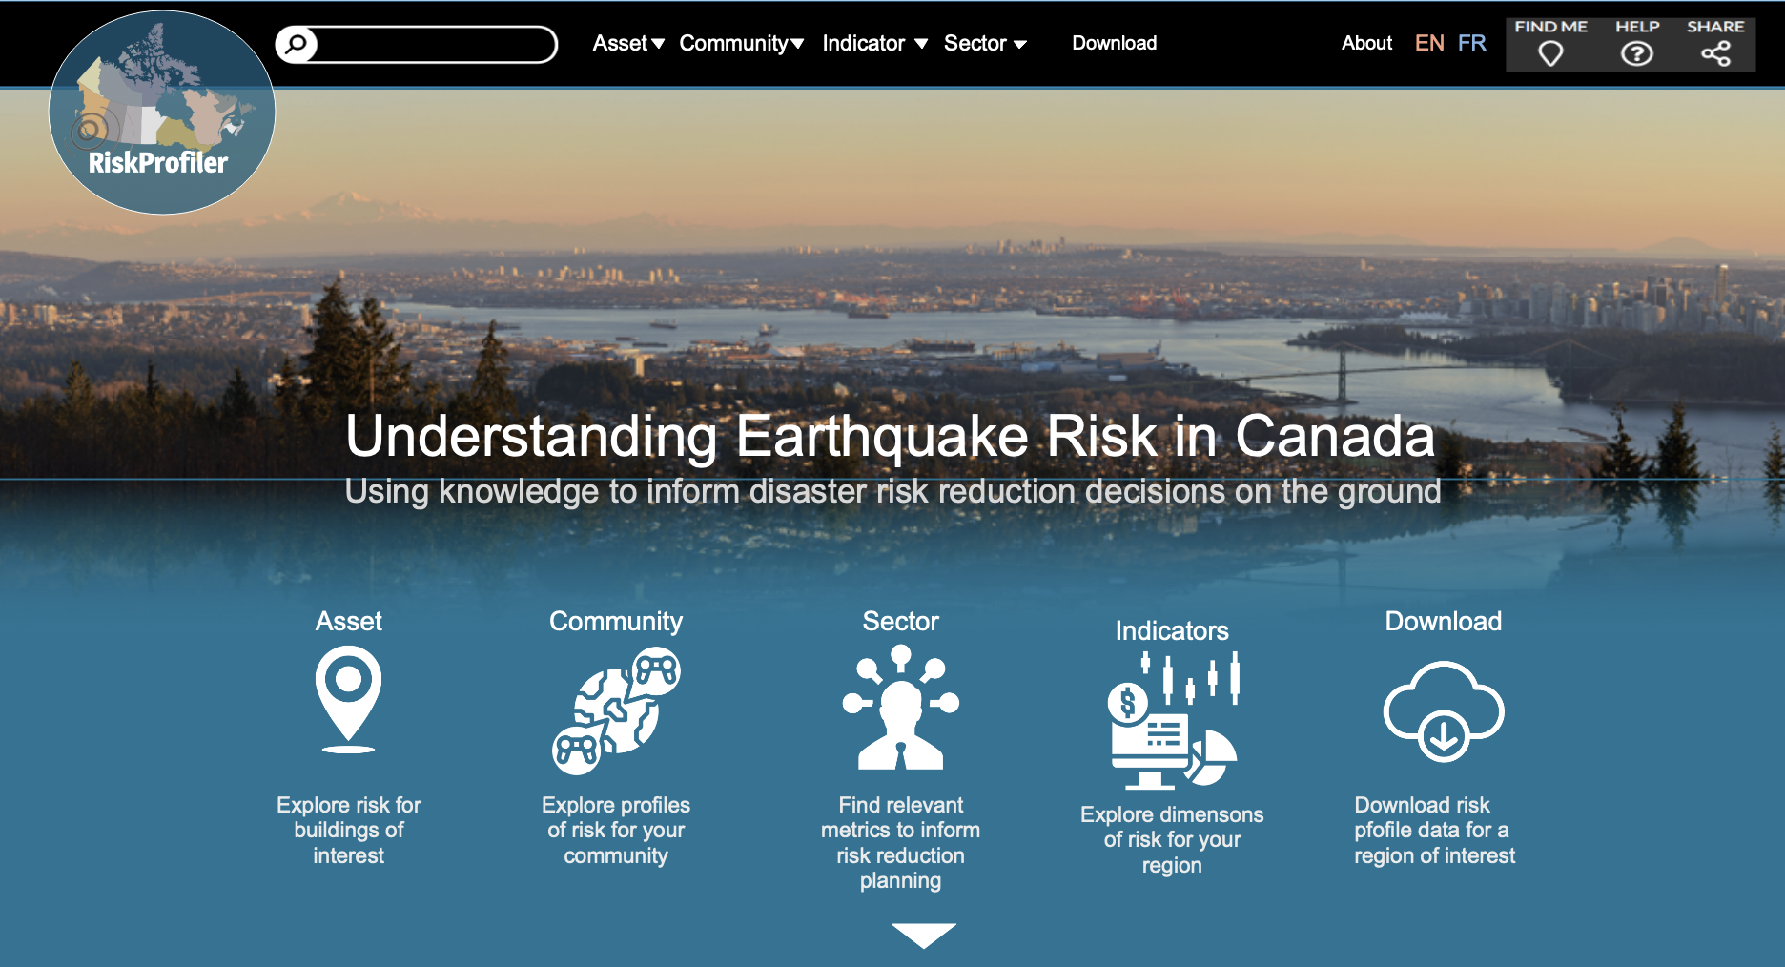
RiskProfiler.ca
Exploring a better way to share knowledge and empower disaster risk reduction …
Kick-Off Meeting
GSC Offices, 1500-605 Robson St.

Slide 2
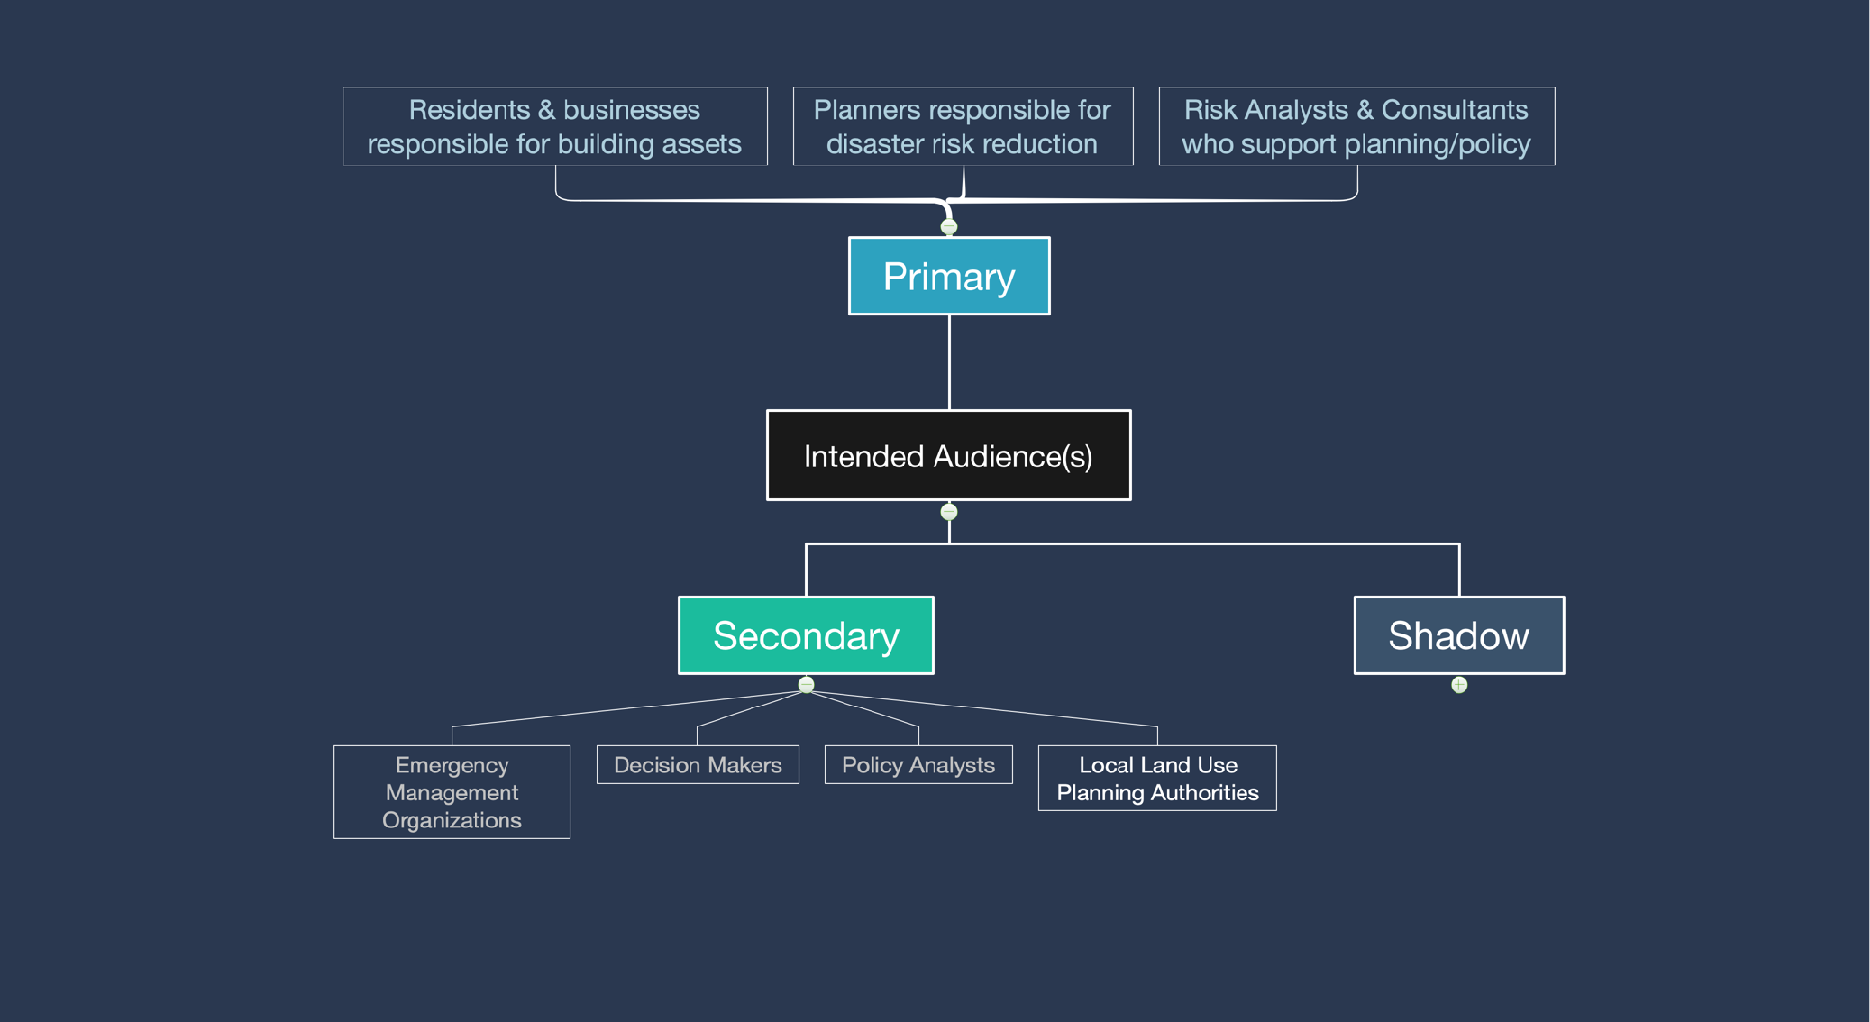
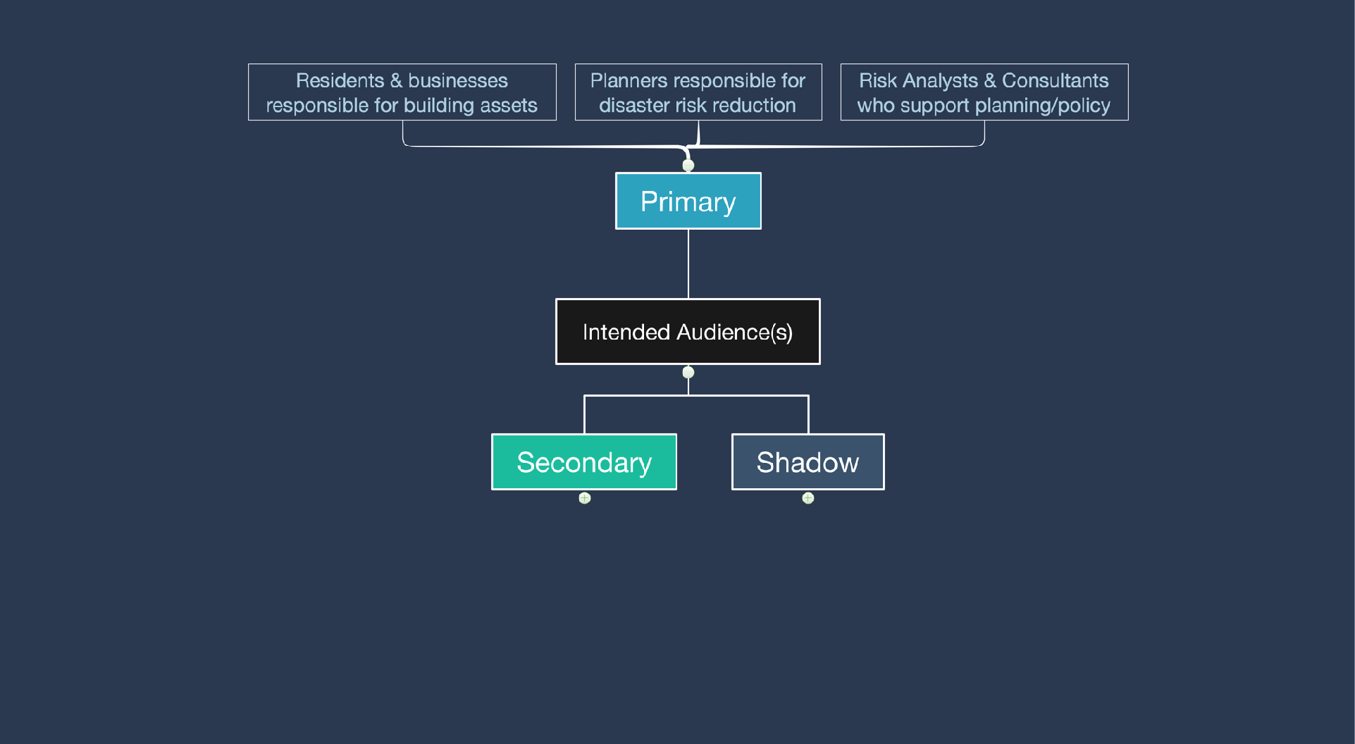
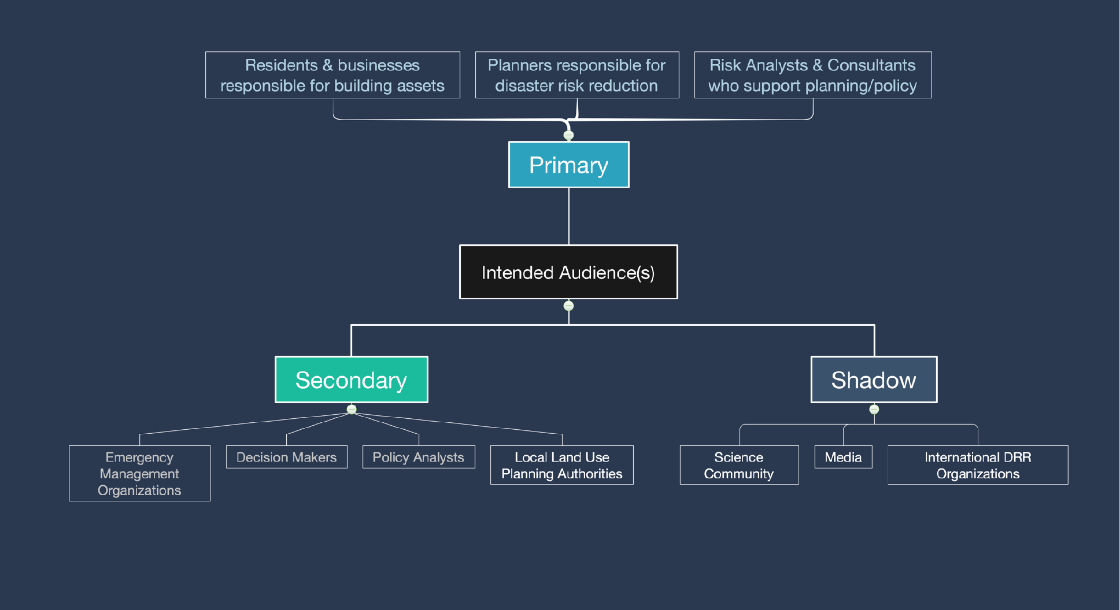

Slide 3


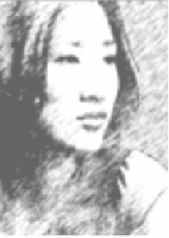
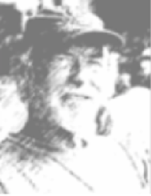
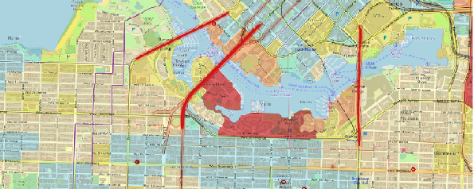
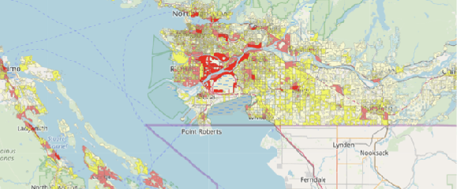

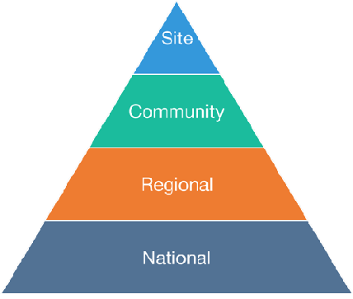
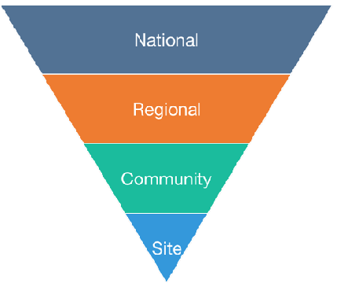
Resident
Business Owner
Planner
Risk Analyst
Focus
Context
Context
Focus

Slide 4
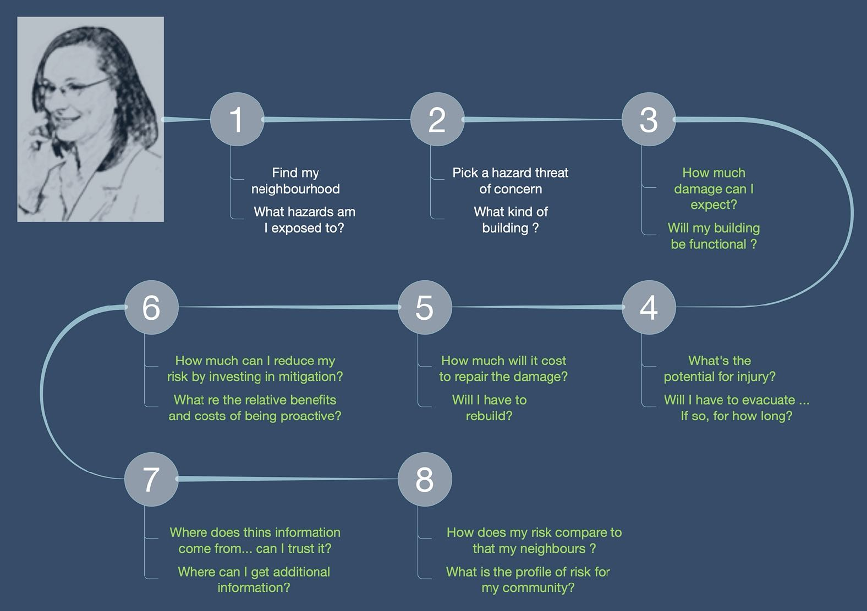
Resident/Business

Slide 5
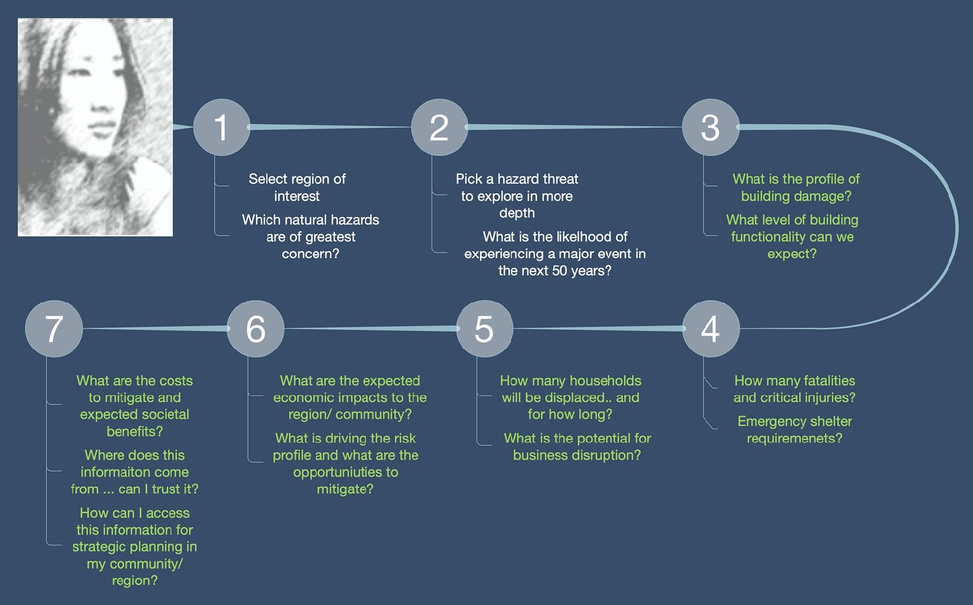
Planner

Slide 7
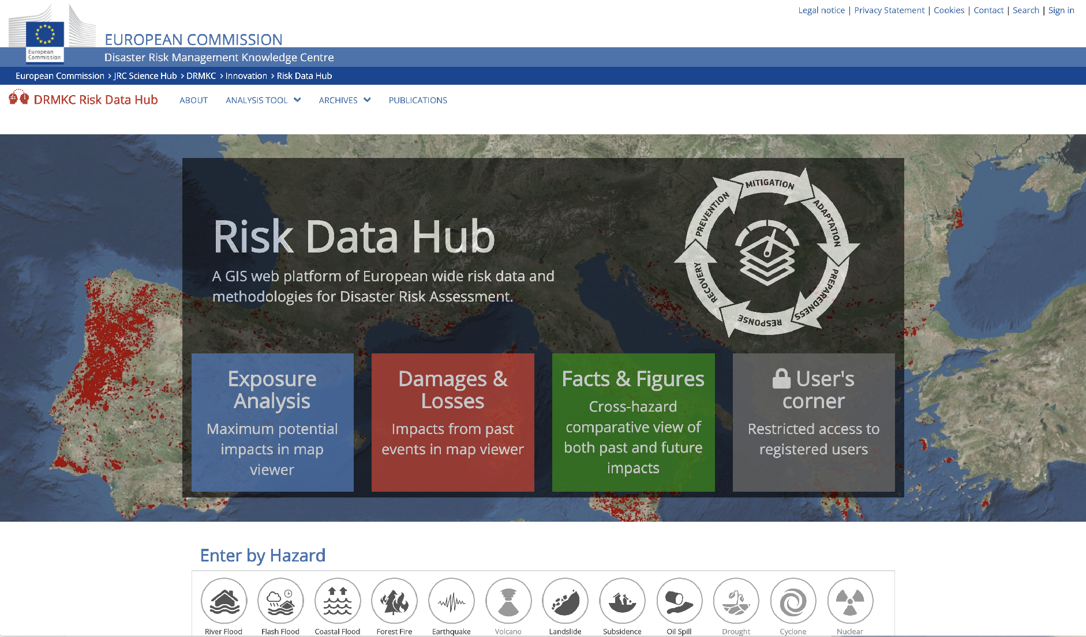
https://drmkc.jrc.ec.europa.eu/risk-data-hub

Slide 8
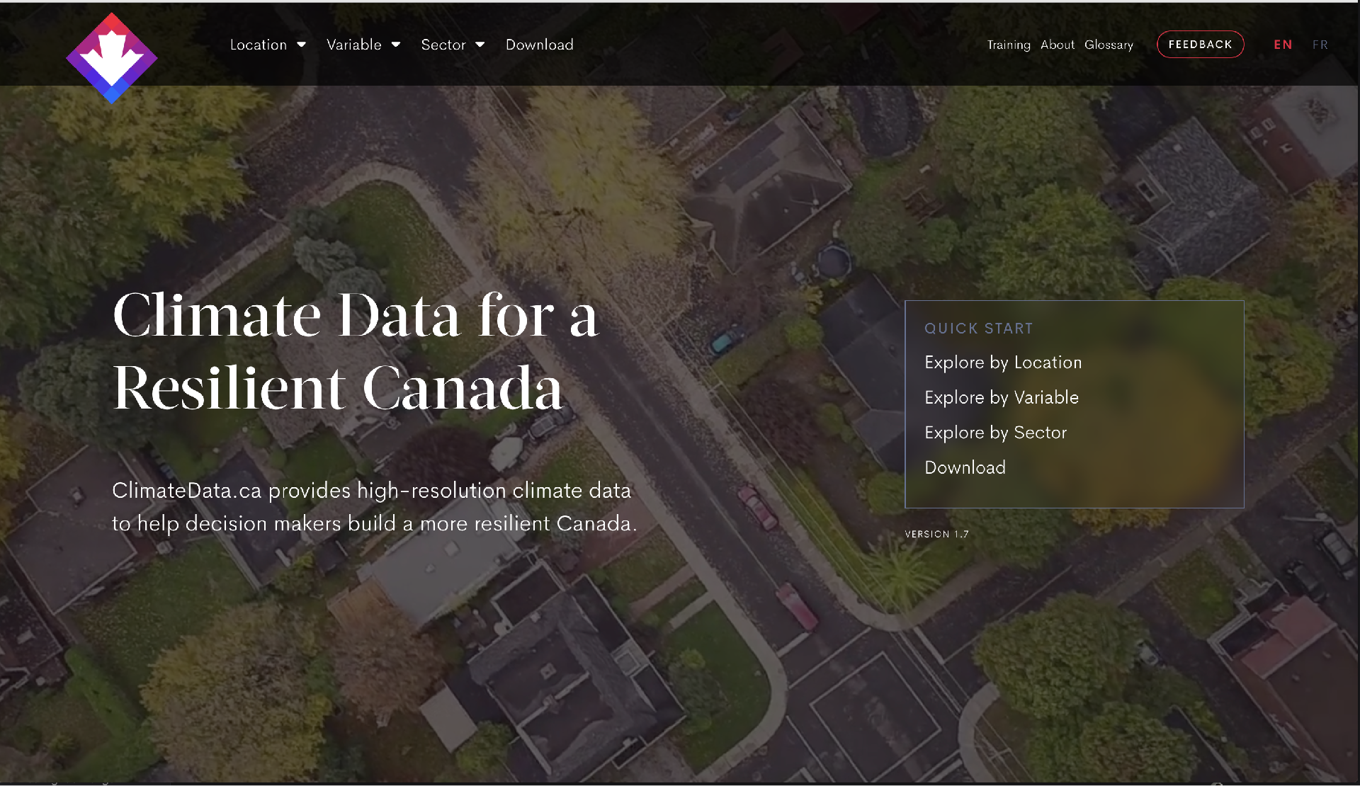
ELK Stack demo – Kibana Dashboard
https://climatedata.ca/

Slide 9

Questions ?
murray.journeay@canada.ca
phone: 604-666-1130

Slide 10
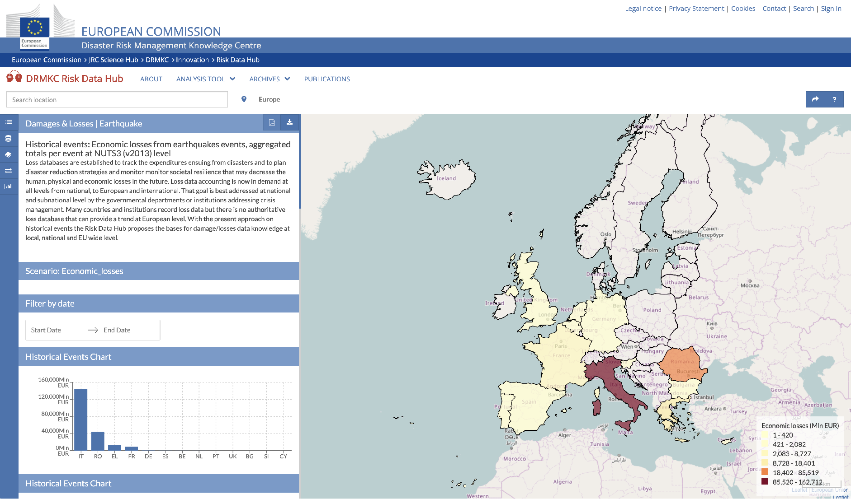
https://drmkc.jrc.ec.europa.eu/risk-data-hub

Slide 11
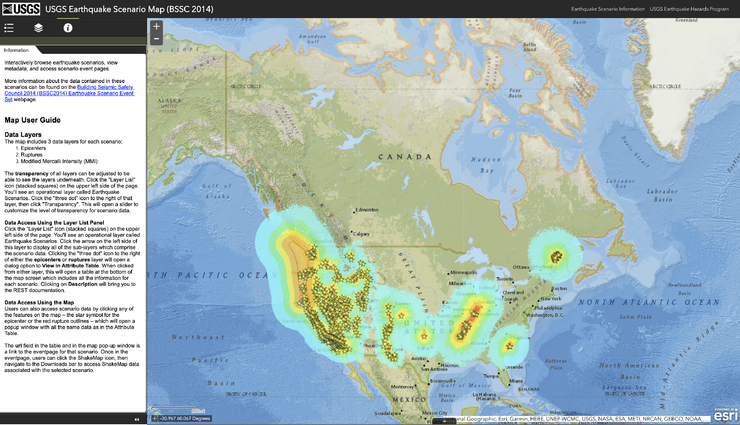
https://usgs.maps.arcgis.com/apps/webappviewer/index.html?id=14d2f75c7c4f4619936dac0d14e1e468

Slide 12
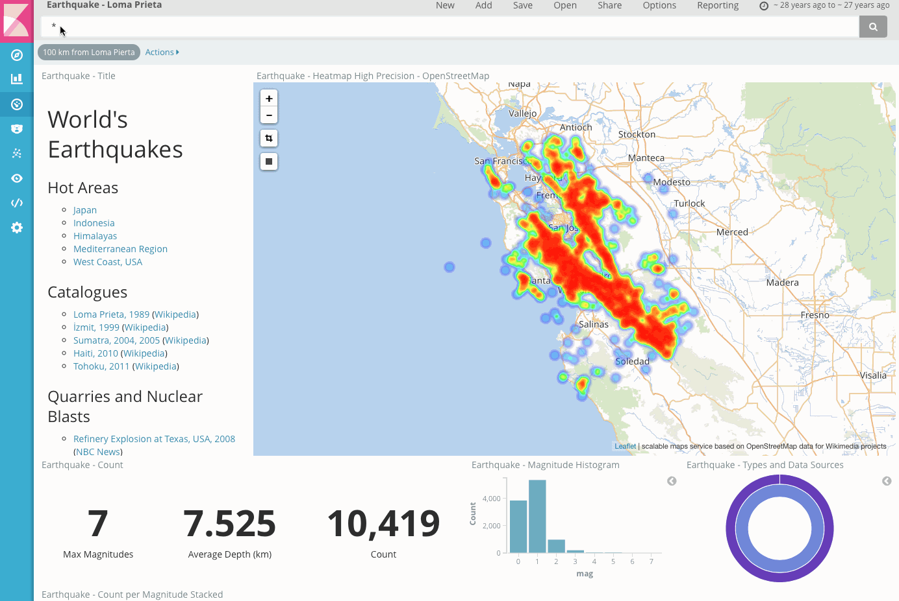

Slide 13
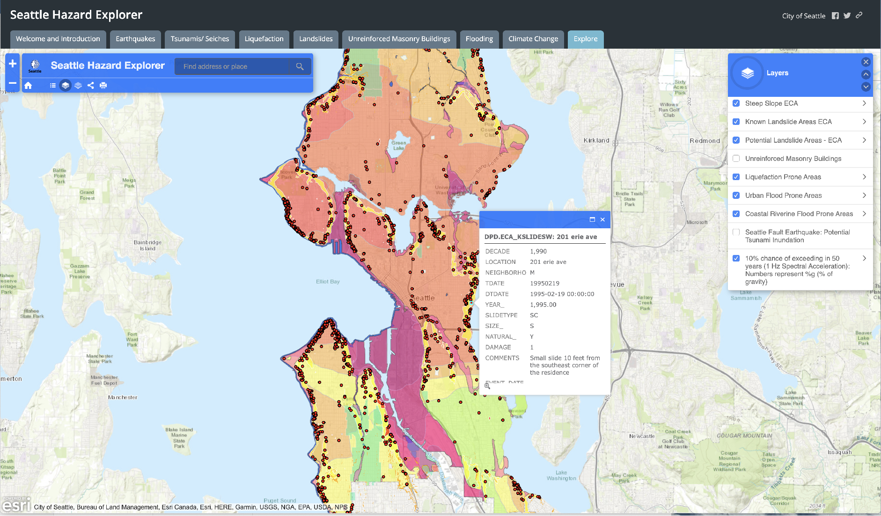
http://seattlecitygis.maps.arcgis.com/apps/MapSeries/index.html?appid=0489a95dad4e42148dbef571076f9b5b

Slide 14
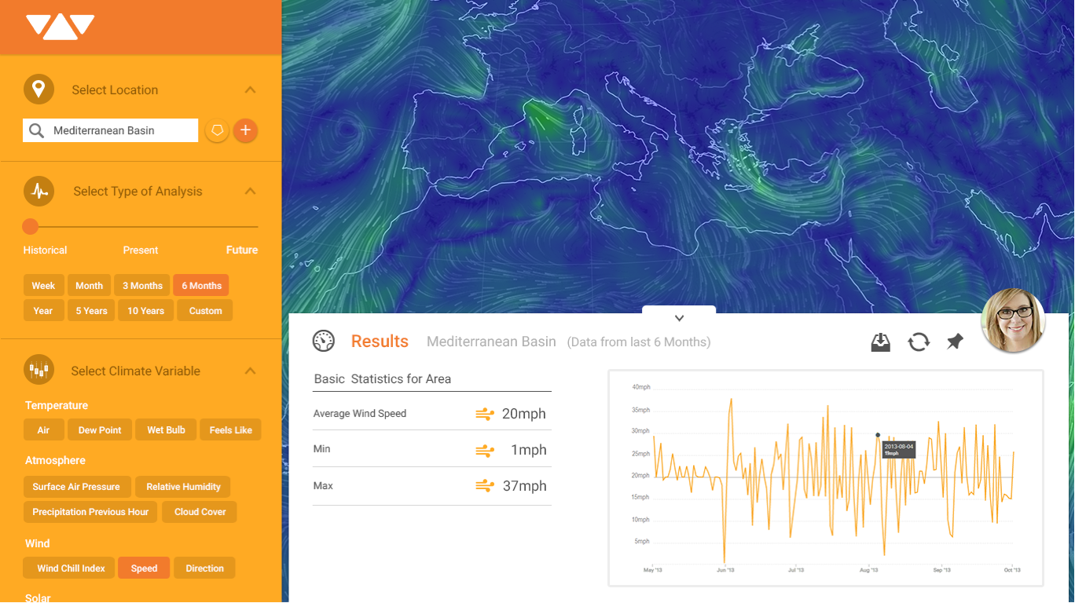
Vizonomy - dashboard

Slide 15
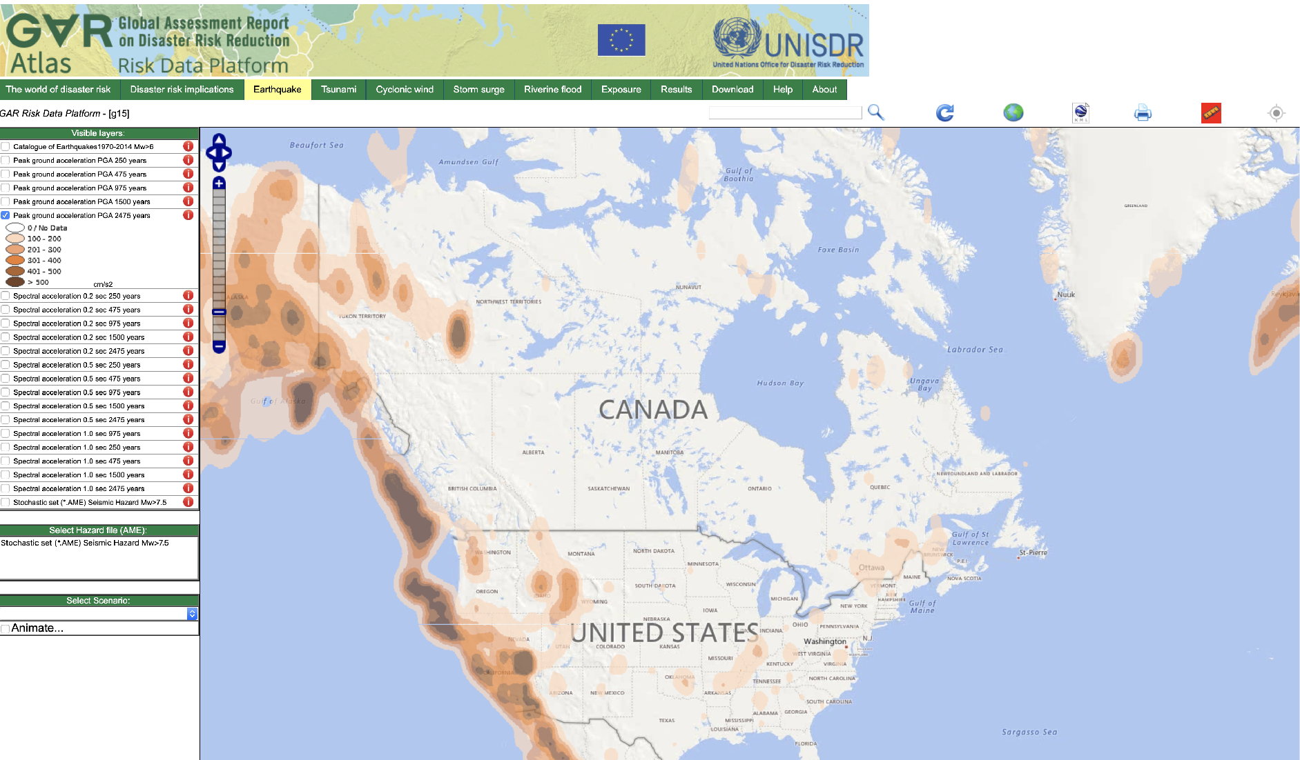
https://risk.preventionweb.net/capraviewer/main.jsp?tab=2&mapcenter=-6006675.6750157,7070959.4351314&mapzoom=4

